Slide 1



Overwhelmed by Information? Summarization, simplification, and information extraction at your fingertips
Horacio Saggion
Large Scale Text Understanding Systems Lab
TALN Group
Universitat Pompeu Fabra
@h_saggion
http://www.dtic.upf.edu/~hsaggion

Slide 2

I want to study irony detection!!!

Slide 3

I want to automatically identify definitions in free text!!!
I want to study irony detection!!!

Slide 4

I want to automatically identify definitions in free text!!!
I want to study irony detection!!!
We need to study deep machine learning architectures !!!

Slide 5





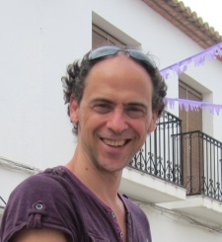



????

Slide 6

> 57M records
> 24M records
????
> 90M records
> 180M records
> 80M records
> 400K full articles
> 2.5M applications
(since 2006)

Slide 7

Scientific Information Overload
> 57M records
> 24M records
> 90M records
> 180M records
> 80M records
> 400K full articles
> 2.5M applications
(since 2006)

Slide 8
Opportunities
Transforming information into Structured Knowledge
Devise better Question Answering Systems
Improve the creation of Scientific Summaries
Obtain the key information for my state of the art report
Knowledge will allow machines
Find hidden connections between papers
Perform automated reasoning
Propose problems to solve
Propose hypothesis to test

Slide 9


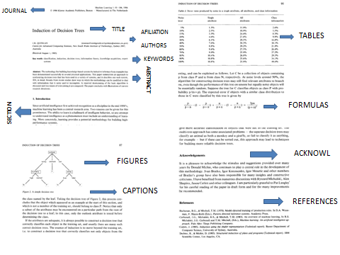
http://drinventor.eu/
Dr Inventor Project (2014-2017)– 7th Framework
Project in the area of Scientific Creativity
Support Scientific Creativity through identification of analogical comparisons (bisociations) between scientific publications
Scientific publication
mainly PDF!
Follow specific patterns of
scientific argumentation
Praise, criticise, compare,
mention previous work

Slide 10




(Fisas et al., 2016) LREC
ANNOTE
(Web-based Collaborative Annotation Tool)
.

Slide 11

(Fisas et al., 2016) LREC
Background
Approach
ANNOTE
(Web-based Collaborative Annotation Tool)
Challenge
Outcome
RHETORICAL
INFORMATION
What is the CHALLENGE faced by the author(s)?
Future Work
A
D
N
C
L
What is the OUTCOME of the experiment
.
Dr Inventor Annotated Corpus

Slide 12


(Fisas et al., 2016) LREC
ANNOTE
(Web-based Collaborative Annotation Tool)
RHETORICAL
INFORMATION
What is the CHALLENGE faced by the author(s)?
CITATIONS
I am USING her method
A
D
N
NEUTRAL
C
L
BASIS
What is the OUTCOME of the experiment
USE
.
COMPARE
His approach has LIMITATIONS !
CRITICISM
Dr Inventor Annotated Corpus

Slide 13
(Fisas et al., 2016) LREC
How important is this sentence?
5
ANNOTE
(Web-based Collaborative Annotation Tool)
3
SUMMARIES
4
1
5
2
RHETORICAL
INFORMATION
What is the CHALLENGE faced by the author(s)?
CITATIONS
5: Very Relevant
I am USING her method
4: Relevant
A
D
N
3: Could be included
C
L
2: Shouldn't be included
What is the OUTCOME of the experiment
1: Totally irrelevant
.
His approach has LIMITATIONS !
Dr Inventor Annotated Corpus

Slide 14
(Fisas et al., 2016) LREC
How important is this sentence?
5
ANNOTE
(Web-based Collaborative Annotation Tool)
3
SUMMARIES
4
1
5
2
RHETORICAL
INFORMATION
What is the CHALLENGE faced by the author(s)?
CITATIONS
I am USING her method
A
D
N
C
L
What is the OUTCOME of the experiment
.
His approach has LIMITATIONS !
FULLY ANNOTATED
DR INVENTOR
CORPUS
Dr Inventor Annotated Corpus

Slide 15
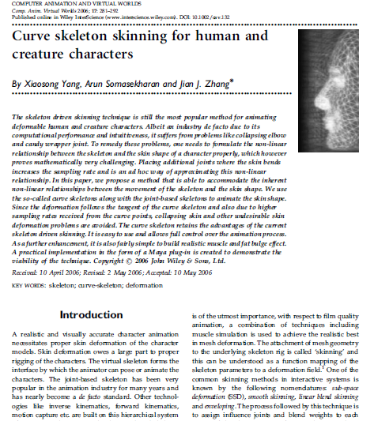
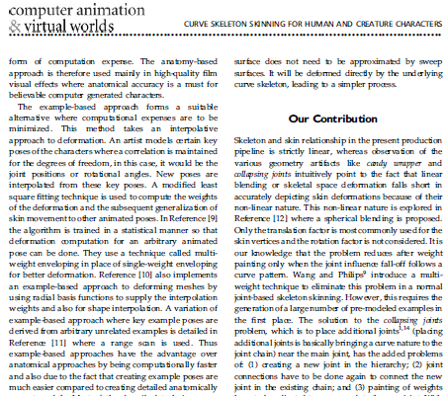
PFD/XML IMPORTER
WORD & SENTENCE IDENTIFICATION
Deep Analysis of Scientific Papers
IDENTIFY & LINK CITATIONS
CITATION ENRICHMENT
PARSING
COREFERENCE RESOLUTION
CAUSALITY IDENTIFICATION
RHETORICAL ANNOTATION
CITATION PURPOSE
INFORMATION EXTRACTION
SUMMARIZATION
(Ronzano & Saggion, 2015) Discovery Science

Slide 16

PFD/XML IMPORTER
WORD & SENTENCE IDENTIFICATION
Deep Analysis of Scientific Papers
IDENTIFY & LINK CITATIONS
CITATION ENRICHMENT
PARSING
TITLE
COREFERENCE RESOLUTION
AUTHORS
GROBID
CAUSALITY IDENTIFICATION
RHETORICAL ANNOTATION
ABSTRACT
CITATION PURPOSE
INFORMATION EXTRACTION
SUMMARIZATION
SECTION
(Ronzano & Saggion, 2015) Discovery Science

Slide 17

PFD/XML IMPORTER
WORD & SENTENCE IDENTIFICATION
Deep Analysis of Scientific Papers
IDENTIFY & LINK CITATIONS
CITATION ENRICHMENT
PARSING
COREFERENCE RESOLUTION
SENTENCE
CAUSALITY IDENTIFICATION
The method is inspired by the area conservation property, even though Section 3.3 points out that the empiricism introduced later does not actually conserve the area.
RHETORICAL ANNOTATION
CITATION PURPOSE
INFORMATION EXTRACTION
SUMMARIZATION
(Ronzano & Saggion, 2015) Discovery Science

Slide 18
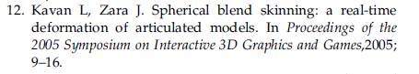
PFD/XML IMPORTER
WORD & SENTENCE IDENTIFICATION
Deep Analysis of Scientific Papers
IDENTIFY & LINK CITATIONS
CITATION ENRICHMENT
PARSING
COREFERENCE RESOLUTION
CAUSALITY IDENTIFICATION
RHETORICAL ANNOTATION
CITATION PURPOSE
INFORMATION EXTRACTION
SUMMARIZATION
(Ronzano & Saggion, 2015) Discovery Science

Slide 19




PFD/XML IMPORTER
WORD & SENTENCE IDENTIFICATION
Deep Analysis of Scientific Papers
IDENTIFY & LINK CITATIONS
CITATION ENRICHMENT
PARSING
COREFERENCE RESOLUTION
CAUSALITY IDENTIFICATION
RHETORICAL ANNOTATION
CITATION PURPOSE
INFORMATION EXTRACTION
SUMMARIZATION
(Ronzano & Saggion, 2015) Discovery Science

Slide 20
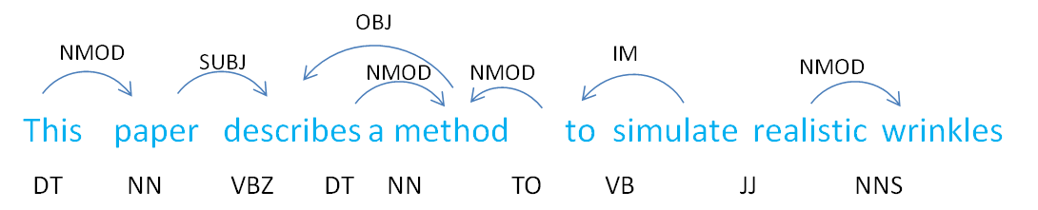
PFD/XML IMPORTER
WORD & SENTENCE IDENTIFICATION
Deep Analysis of Scientific Papers
IDENTIFY & LINK CITATIONS
CITATION ENRICHMENT
PARSING
COREFERENCE RESOLUTION
CAUSALITY IDENTIFICATION
RHETORICAL ANNOTATION
CITATION PURPOSE
INFORMATION EXTRACTION
(Bonhet, 2010) ACL
SUMMARIZATION
(Ronzano & Saggion, 2015) Discovery Science

Slide 21
PFD/XML IMPORTER
WORD & SENTENCE IDENTIFICATION
Deep Analysis of Scientific Papers
IDENTIFY & LINK CITATIONS
CITATION ENRICHMENT
PARSING
Based on
Stanford deterministic
Coreference
Resolution
COREFERENCE RESOLUTION
CAUSALITY IDENTIFICATION
The wrinkling coefficients on the other hand, are computationally expensive. However, as one can see from equation 11 in Appendix A, they depend only on quantities that are known prior to entering the animation loop
RHETORICAL ANNOTATION
CITATION PURPOSE
INFORMATION EXTRACTION
SUMMARIZATION
(Ronzano & Saggion, 2015) Discovery Science

Slide 22
PFD/XML IMPORTER
WORD & SENTENCE IDENTIFICATION
Deep Analysis of Scientific Papers
IDENTIFY & LINK CITATIONS
CITATION ENRICHMENT
Rule-based linguistically motivated approach
PARSING
CAUSE
COREFERENCE RESOLUTION
CAUSALITY IDENTIFICATION
This leads to a smaller number of summation terms needed for the calculation of the deformed skin points (see Equation (3)). As a result, our computation speed is at the same order, but is slightly faster than that of the traditional smooth skinning technique.
to entering the animation loop
RHETORICAL ANNOTATION
CITATION PURPOSE
INFORMATION EXTRACTION
EFFECT
SUMMARIZATION
(Ronzano & Saggion, 2015) Discovery Science

Slide 23
PFD/XML IMPORTER
WORD & SENTENCE IDENTIFICATION
Deep Analysis of Scientific Papers
IDENTIFY & LINK CITATIONS
CITATION ENRICHMENT
PARSING
COREFERENCE RESOLUTION
CHALLENGE
CAUSALITY IDENTIFICATION
…
And with that low-rate sampling they fail to give a good approximation of the deformed skin surface.
to entering the animation loop
RHETORICAL ANNOTATION
CITATION PURPOSE
From the algorithmic point of view, the technique reduces a level of complexity in the skinning and deformation. the
INFORMATION EXTRACTION
OUTCOME
SUMMARIZATION
(Ronzano & Saggion, 2015) Discovery Science

Slide 24
PFD/XML IMPORTER
WORD & SENTENCE IDENTIFICATION
Deep Analysis of Scientific Papers
IDENTIFY & LINK CITATIONS
CITATION ENRICHMENT
PARSING
COREFERENCE RESOLUTION
CRITICISM
CAUSALITY IDENTIFICATION
[ 1 ]. Apart from simulation time, the large triangle count increases the rendering time and the cost significantly …
to entering the animation loop
RHETORICAL ANNOTATION
CITATION PURPOSE
For numerical integration, we used the CG method proposed by Baraff [ 3 ].e cost significantly
INFORMATION EXTRACTION
USE / METHOD / TOOL
SUMMARIZATION
(Ronzano & Saggion, 2015) Discovery Science

Slide 25
PFD/XML IMPORTER
WORD & SENTENCE IDENTIFICATION
Deep Analysis of Scientific Papers
IDENTIFY & LINK CITATIONS
CITATION ENRICHMENT
PARSING
COREFERENCE RESOLUTION
PAPER
CAUSALITY IDENTIFICATION
RHETORICAL ANNOTATION
PRESENT
REALISTIC WRINKLES
CITATION PURPOSE
METHOD
INFORMATION EXTRACTION
SIMULATE
SUMMARIZATION
(Ronzano & Saggion, 2015) Discovery Science

Slide 26

PFD/XML IMPORTER
WORD & SENTENCE IDENTIFICATION
Deep Analysis of Scientific Papers
IDENTIFY & LINK CITATIONS
CITATION ENRICHMENT
PARSING
COREFERENCE RESOLUTION
CAUSALITY IDENTIFICATION
In this paper, we introduce a novel method called curve skeleton skinning, to overcome the persisting drawbacks of joint skeleton skinning…
One of the main advantages of the curve skeleton skin deformation technique is that, the curve skeleton needs not necessarily be placed on the underlying joint skeleton.
RHETORICAL ANNOTATION
CITATION PURPOSE
INFORMATION EXTRACTION
SUMMARIZATION
(Codina-Filbà et al., 2017) IP&M
(Saggion et al., 2016) BIRNDL@JCDL

Slide 27

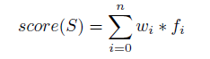
Summarizing Scientific Articles
Summarizing Computer Graphics Articles
Dr Inventor Dataset Annotated with
sentence relevance values (0-5)
+ 3 expert summaries per articles
Designed, based on peer-reviewed literature, a set of summarization sentence relevance features
Document structure
Vocabulary / Citations
Term distribution
Rhetorical Information
Text similarity computation
Centrality information
Coreference
Learn to score sentences based on
linear regression
Our method outperforms (statistically) competitive centrality-based approaches (e.g., LexRank) and baselines (e.g., Frequency, Position)
5
3
4
1
5
2
(Codina-Filbà et al., 2017) IP&M
(Saggion et al., 2016) BIRNDL@JCDL

Slide 28
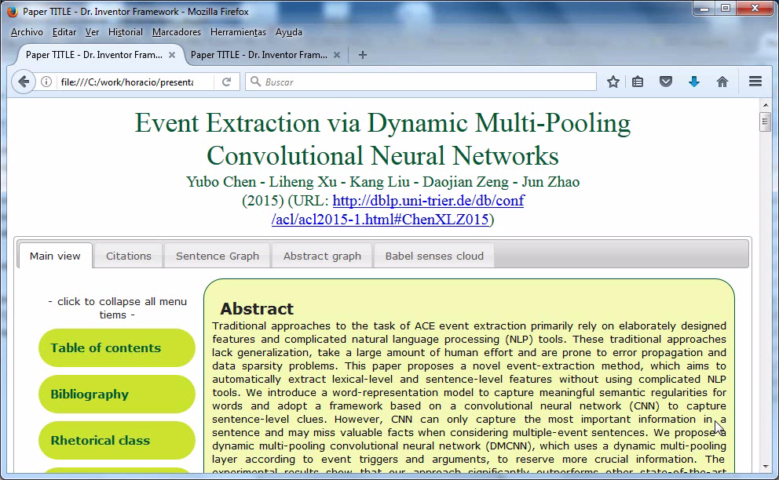

Slide 29


Dr Inventor Text Mining Library
Available at http://backingdata.org/dri/library
Self contained Java library managed by Maven
Extensive documentation and examples
Exposes an API for convenient access to information mined from papers
Incorporates Web services to support several text enrichment processes

Slide 30
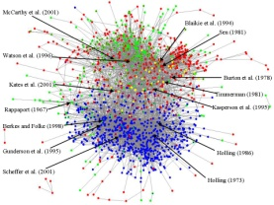
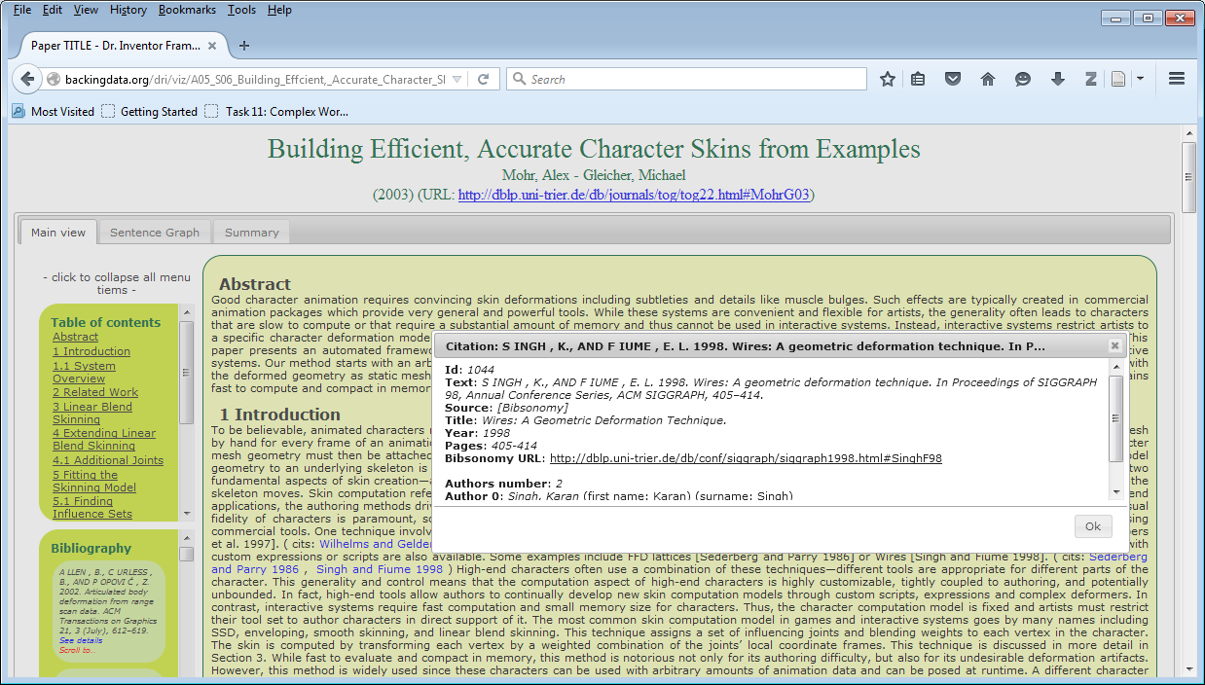

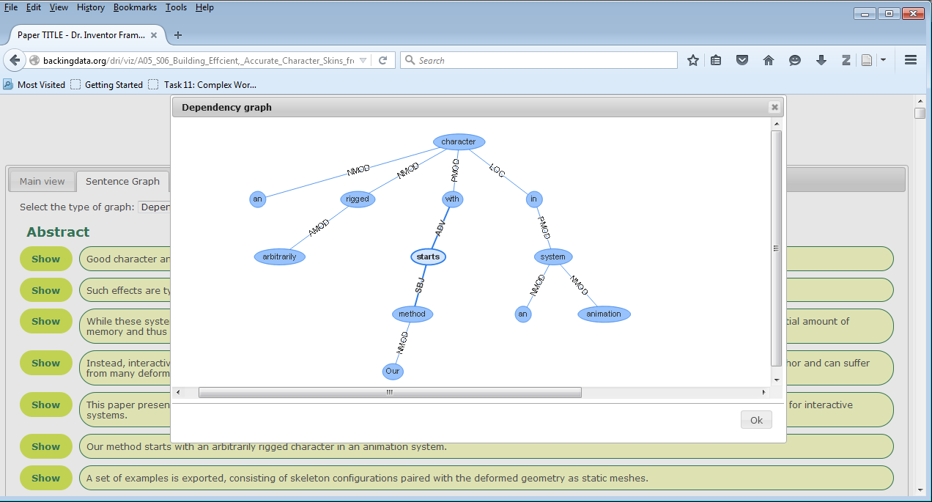
?
Online Scientific Publications
Crawler
Analysis
Storage
Indexing

Slide 31
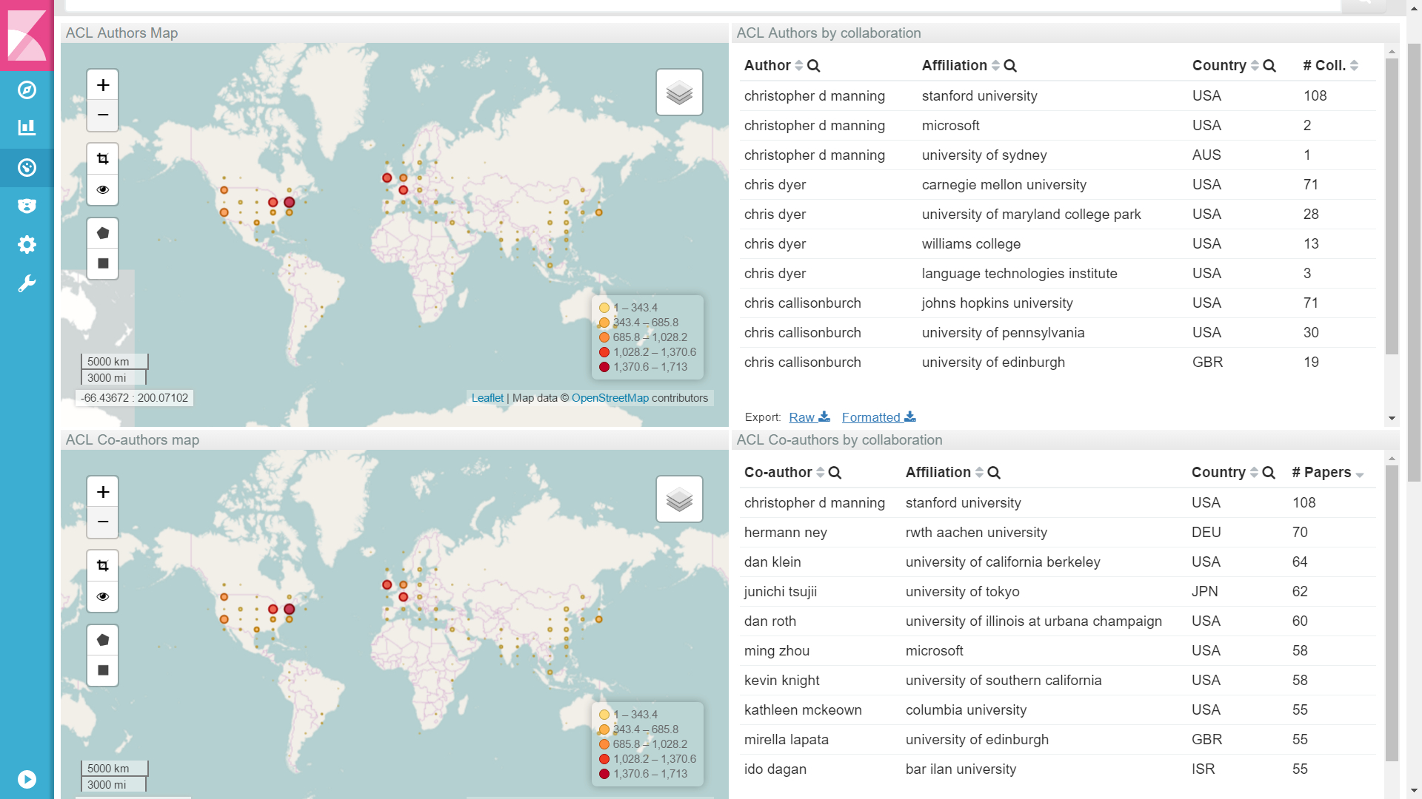

Which countries publish in ACL events?
Who is publishing in ACL related events?

Slide 32
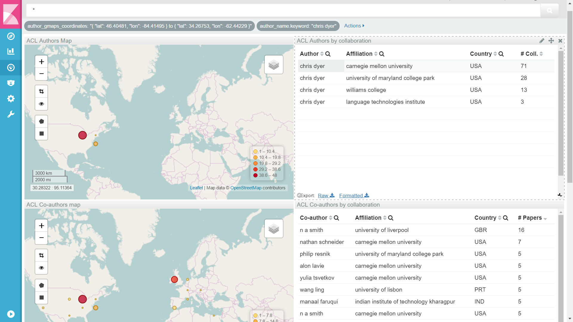
Who collaborates with Chris Dyer?
Where are Chris Dyer collaborators?

Slide 33
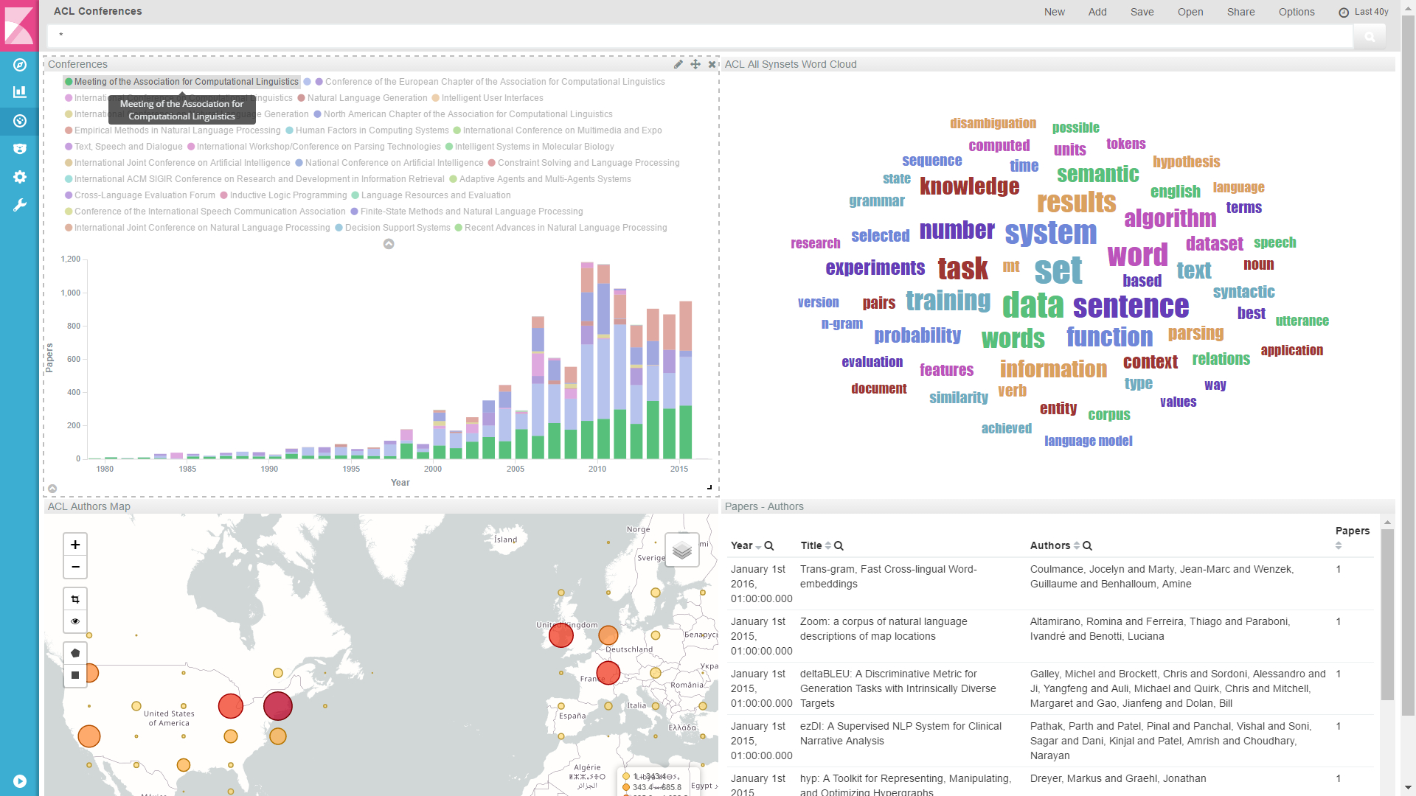
How many papers have beem published in ACL related events?
What are these conferences about?

Slide 34
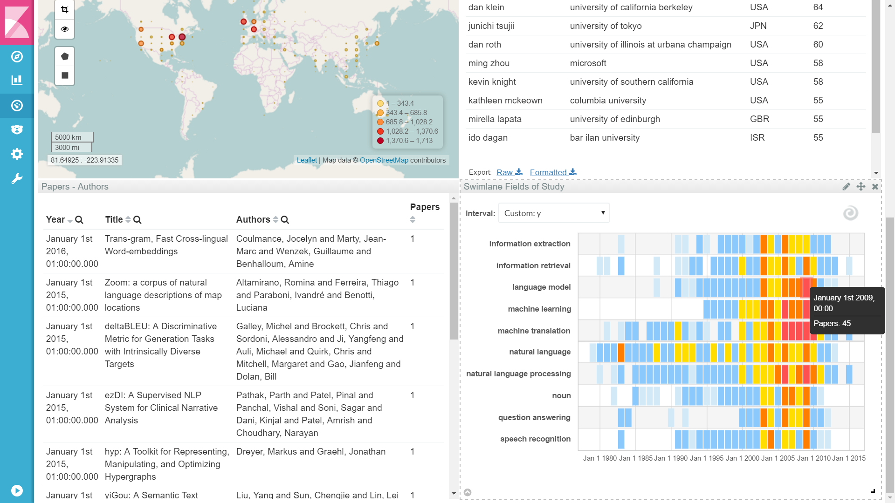
How ACL topics have evolved?

Slide 35
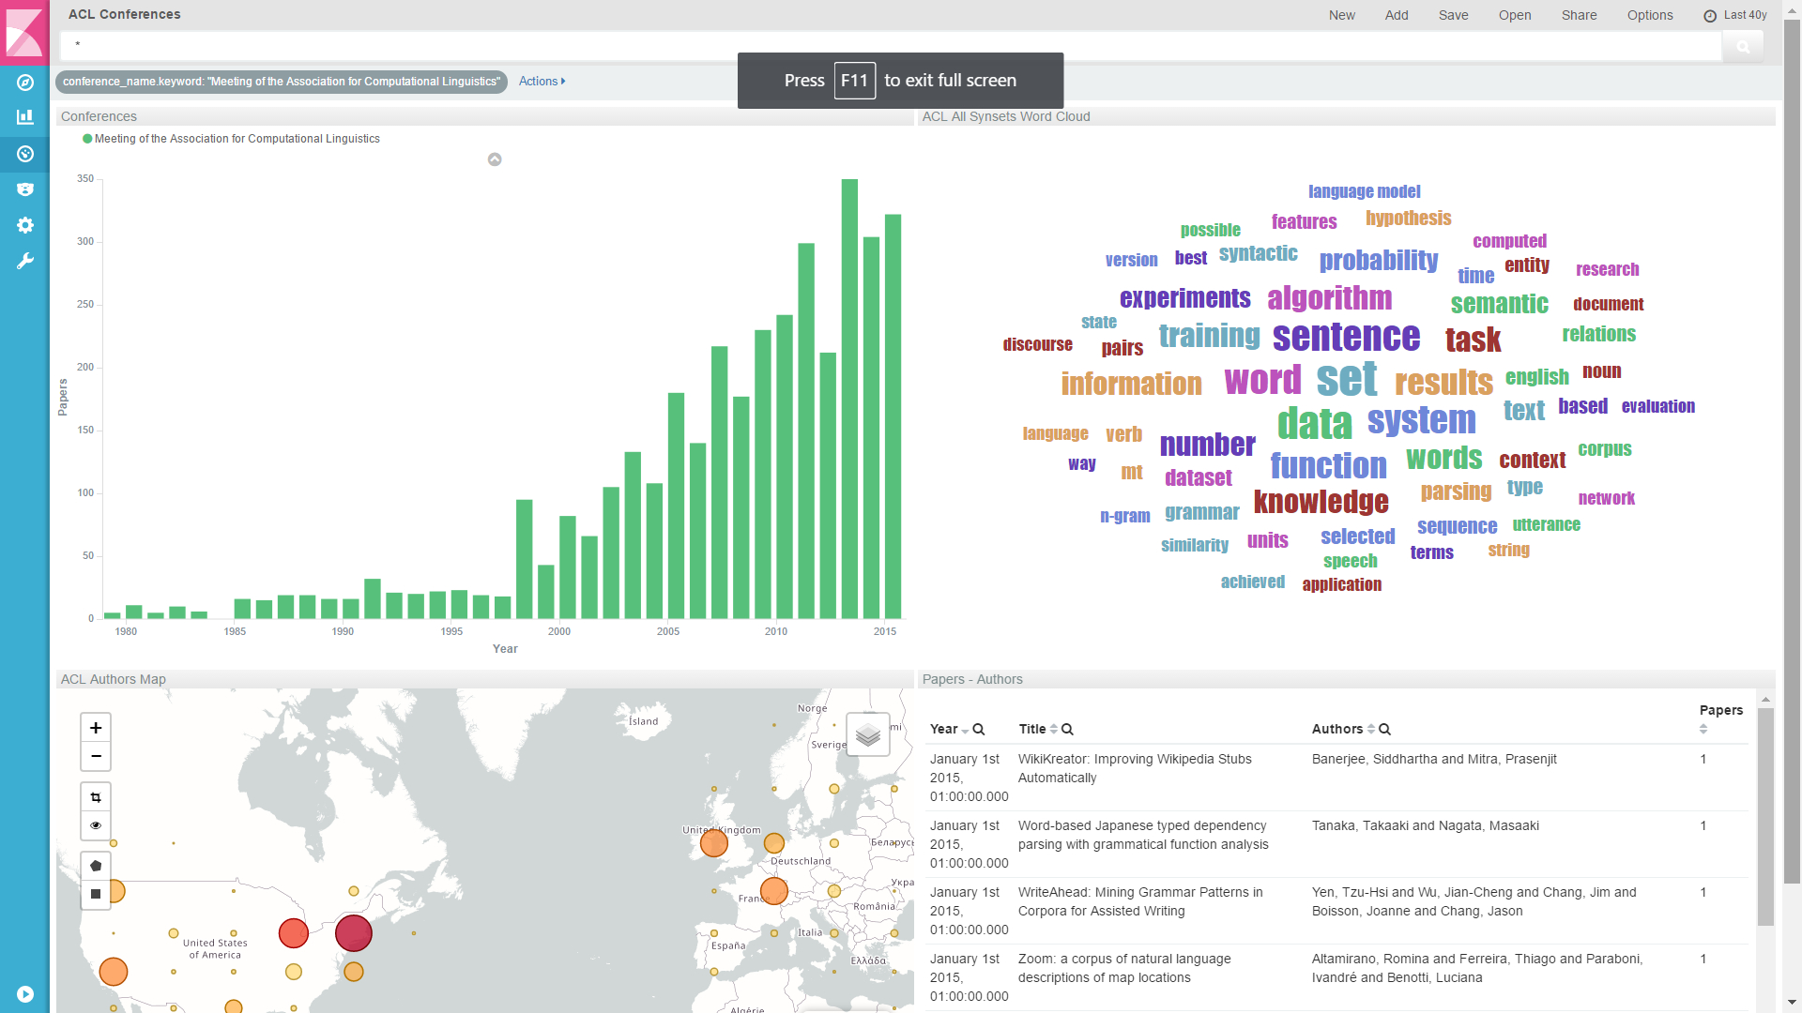
How popular is ACL main conference?

Slide 36
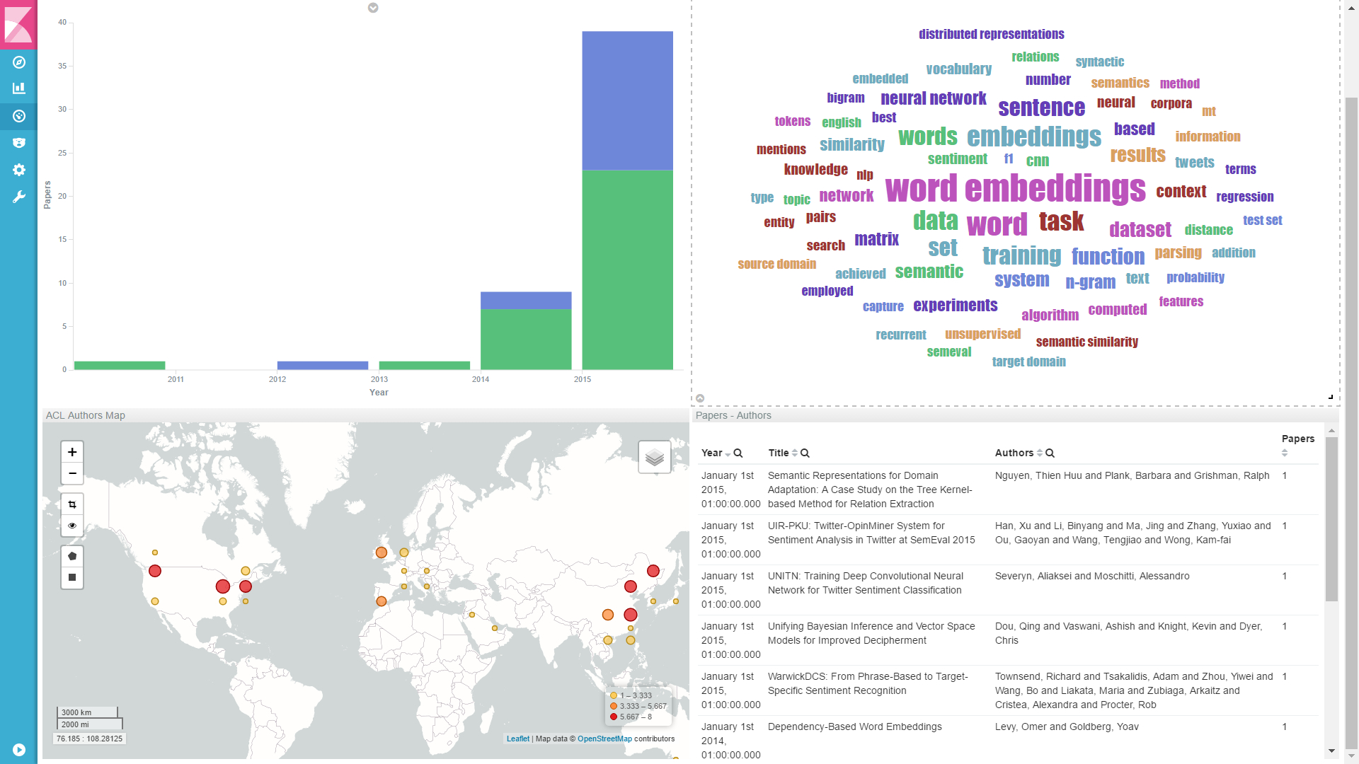
What is the evolution of “word embeddings” in ACL confs?

Slide 37
Text Simplification
Texts are sometimes too complicated: long sentences, uncommon vocabulary
Wikipedia: Opera is an art form in which singers and musicians perform a dramatic work combining text (libretto) and musical score, usually in a theatrical setting.

Slide 38

Text Simplification
Texts are sometimes too complicated: long sentences, uncommon vocabulary
Wikipedia: Opera is an art form in which singers and musicians perform a dramatic work combining text (libretto) and musical score, usually in a theatrical setting.
Easy-to-read texts usually contain shorter sentences and common vocabulary

Slide 39
Text Simplification
Texts are sometimes too complicated: long sentences, uncommon vocabulary
Wikipedia: Opera is an art form in which singers and musicians perform a dramatic work combining text (libretto) and musical score, usually in a theatrical setting.
Easy-to-read texts usually contain shorter sentences and common vocabulary
Simple Wikipedia: Opera is a drama set to music. An opera is like a play in which everything is sung instead of spoken.

Slide 40

Text Simplification
Texts are sometimes too complicated: long sentences, uncommon vocabulary
Wikipedia: Opera is an art form in which singers and musicians perform a dramatic work combining text (libretto) and musical score, usually in a theatrical setting.
Easy-to-read texts usually contain shorter sentences and common vocabulary
Simple Wikipedia: Opera is a drama set to music. An opera is like a play in which everything is sung instead of spoken.
Article 7
Los sindicatos de trabajadores y las asociaciones empresariales contribuyen a la defensa y promoción de los intereses económicos y sociales que les son propios.

Slide 41
Text Simplification
Texts are sometimes too complicated: long sentences, uncommon vocabulary
Wikipedia: Opera is an art form in which singers and musicians perform a dramatic work combining text (libretto) and musical score, usually in a theatrical setting.
Easy-to-read texts usually contain shorter sentences and common vocabulary
Simple Wikipedia: Opera is a drama set to music. An opera is like a play in which everything is sung instead of spoken.
Article 7
Los sindicatos de trabajadores y las asociaciones empresariales contribuyen a la defensa y promoción de los intereses económicos y sociales que les son propios.
Los trabajadores defienden sus intereses a través de los sindicatos.
Las empresas defienden sus intereses a través de sus asociaciones

Slide 42


Text Simplification
Texts are sometimes too complicated: long sentences, uncommon vocabulary
Wikipedia: Opera is an art form in which singers and musicians perform a dramatic work combining text (libretto) and musical score, usually in a theatrical setting.
Easy-to-read texts usually contain shorter sentences and common vocabulary
Simple Wikipedia: Opera is a drama set to music. An opera is like a play in which everything is sung instead of spoken.
French authorities began clearing out the sprawling Calais 'Jungle' camp on Monday, with the first government buses shuttling migrants to accommodation centers leaving the camp in the morning.

Slide 43

Text Simplification
Texts are sometimes too complicated: long sentences, uncommon vocabulary
Wikipedia: Opera is an art form in which singers and musicians perform a dramatic work combining text (libretto) and musical score, usually in a theatrical setting.
Easy-to-read texts usually contain shorter sentences and common vocabulary
Simple Wikipedia: Opera is a drama set to music. An opera is like a play in which everything is sung instead of spoken.
French authorities began clearing out the sprawling Calais 'Jungle' camp on Monday, with the first government buses shuttling migrants to accommodation centers leaving the camp in the morning.
A camp for migrants and refugees in France has been closed. The camp was near a town called Calais.

Slide 44

Text Simplification
Texts are sometimes too complicated: long sentences, uncommon vocabulary
Wikipedia: Opera is an art form in which singers and musicians perform a dramatic work combining text (libretto) and musical score, usually in a theatrical setting.
Easy-to-read texts usually contain shorter sentences and common vocabulary
Simple Wikipedia: Opera is a drama set to music. An opera is like a play in which everything is sung instead of spoken.
The Parliament of the United Kingdom, commonly known as the UK Parliament or British Parliament, is the supreme legislative body in the United Kingdom, British Crown dependencies and British overseas territories.

Slide 45
Text Simplification
Texts are sometimes too complicated: long sentences, uncommon vocabulary
Wikipedia: Opera is an art form in which singers and musicians perform a dramatic work combining text (libretto) and musical score, usually in a theatrical setting.
Easy-to-read texts usually contain shorter sentences and common vocabulary
Simple Wikipedia: Opera is a drama set to music. An opera is like a play in which everything is sung instead of spoken.
The Parliament of the United Kingdom, commonly known as the UK Parliament or British Parliament, is the supreme legislative body in the United Kingdom, British Crown dependencies and British overseas territories.
Parliament is a group of people who make laws and check what the Government is doing.

Slide 46
Text Simplification
Adapting the content of a text can be beneficial for different users
language impairment
learning second language
non specialists in a domain
Manual adaptation is costly and time consuming
aphasia
autism spectrum disorder
dyslexia
intellectual disability

Slide 47


Text Simplification
Adapting the content of a text can be beneficial for different users
language impairment
learning second language
non specialists in a domain
Manual adaptation is costly and time consuming
aphasia
autism spectrum disorder
dyslexia
intellectual disability
First text simplification system for Spanish
Accessible technology in the information society

Slide 48

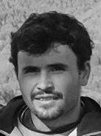
Text Simplification
Adapting the content of a text can be beneficial for different users
language impairment
learning second language
non specialists in a domain
Manual adaptation is costly and time consuming
aphasia
autism spectrum disorder
dyslexia
intellectual disability
First text simplification system for Spanish
Accessible technology in the information society

Slide 49
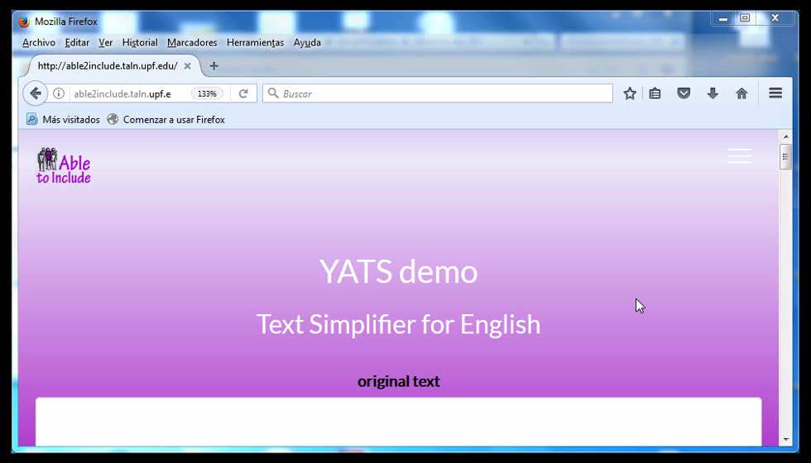
Can We Automate the Production of Easy Texts?

Slide 50
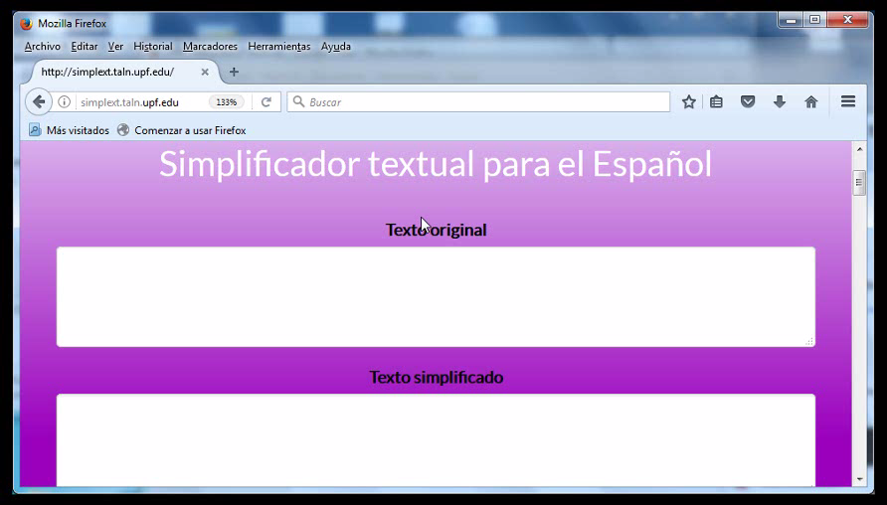
Can We Automate the Production of Easy Texts?

Slide 51
How to Make the Machine Actually Simplify a Text?
Lexical Simplification
Find Simple Synonyms
WordNet©
car
car, automobile, auto, ….
Text Analysis
Word Sense Disambiguation
Your automobile has been repaired ..
PRP$
NN
VBZ
VBN
VBN
repair, mend, fix, ….
fix
WordNet©
Complex Word Identification
compensate, recompense, repair,, …
Simplest Synonym
amend, rectify,
Sentence Generation
Your car has been fixed.
(Saggion et al., 2016a) Comp. Speech & Lang. (Ferrès et al., 2016) NLDB (Ronzano et al., 2016) SemEval

Slide 52
How to Make the Machine Actually Simplify a Text?
Syntactic Simplification
Text Analysis
SUBJ
NMOD
SUBJ
VC
TMP
PMOD
LOC
PMOD
Eva , whose son was born in 2010 , lives in France ..
NNP
WP$
NN
VBD
VBN
IN
CD
VBZ
IN
NNP
Simplification Grammars
Eva lives in France .
Sentence Generation
The son of Eva was born in 2010 .
(Saggion et al., 2016b) TACCESS ; (Ferrès et al., 2016) NLDB

Slide 53
How Good are the Automatically Simplified Texts?
Lexical simplification
Lexical simplification benchmarking dataset
Syntactic simplification
Intrinsic evaluation testing precision of rule application
Full system
Evaluate with human informants: grammar, meaning, simplicity

Slide 54
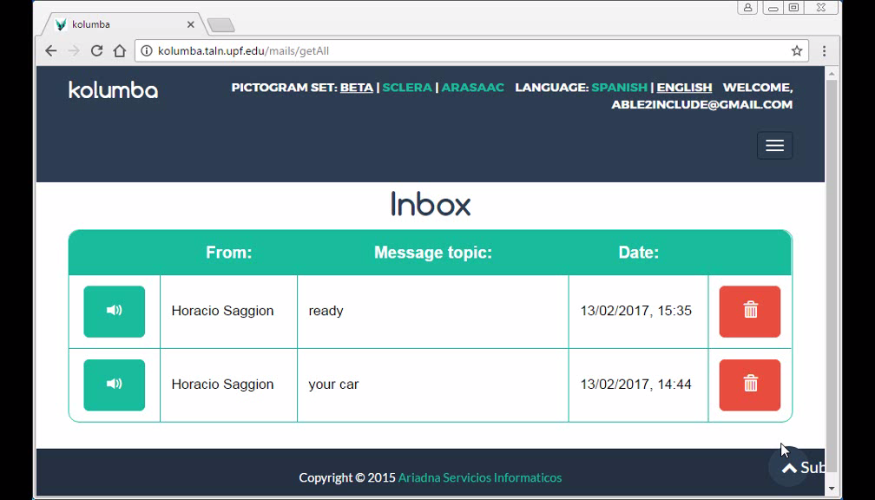
Towards an Accessible e-mail Client
(Saggion et al., 2017) W4ALL

Slide 55



Our Research / Integration
Big (unstructured) Data
Recommendations
Intelligent Search
Draw Inferences
Knowledge
Question Answering
Find Associations
Summarization
Hypothesis

Slide 56
Our Research / Integration
Big (unstructured) Data
Recommendations
Intelligent Search
Draw Inferences
Knowledge
Question Answering
Find Associations
Hypothesis
Summarization
Visualization
More than text: Images
Domain Adaptation
Other Types of Scientific Data

Slide 57

Our Research / Integration
Complex Texts
Simpler Versions
Multiple Languages
Tools
Improve Accessibility

Slide 58
Our Research / Integration
Complex Texts
Simpler Versions
Multiple Languages
Tools
Improve Accessibility
Domain Adaptation
(Education, Health)
Human Studies
Creation of Lang. Resources

Slide 59


Overwhelmed by Information? Summarization, simplification, and information extraction at your fingertips
Questions?

